Slide 1


Management of Diabetic Foot Problems
in Western Pacific Region
Shigeo Kono MD, PhD
WHO-collaborating Centre
for Diabetes Treatment
and Education
Kyoto Medical Center
Japan
Kyoto, Japan
Notes:
Thank you very much for your kind introduction. It is a great honor of me to be here to introduce to you “the diabetic foot problem in Japan and the WPR”. First of all, I would like to express my sincere gratitude for giving me this opportunity..

Slide 2

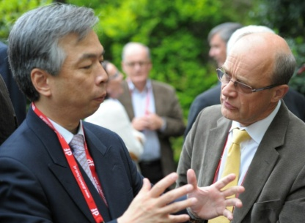
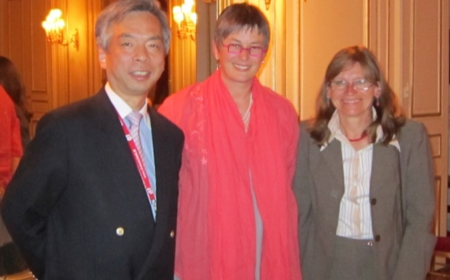
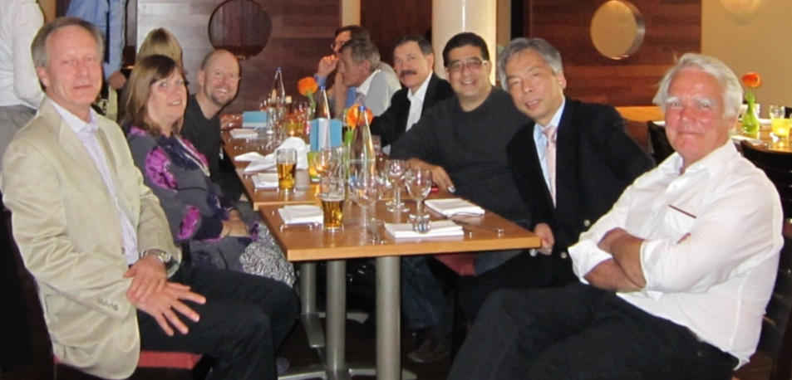
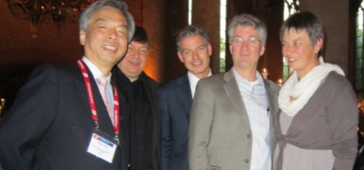
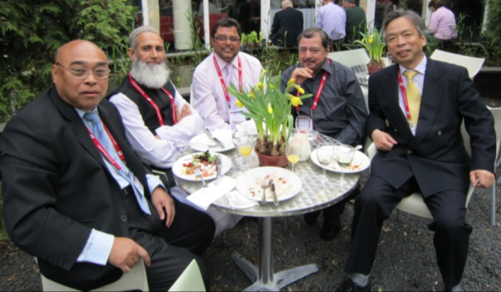
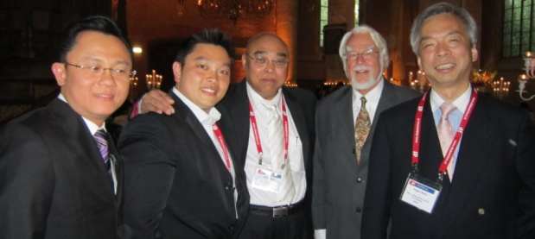
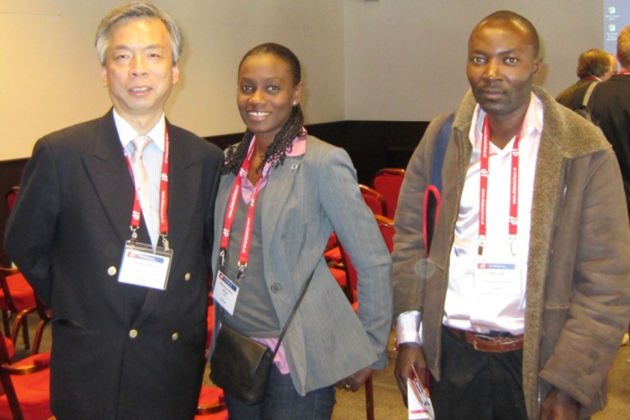
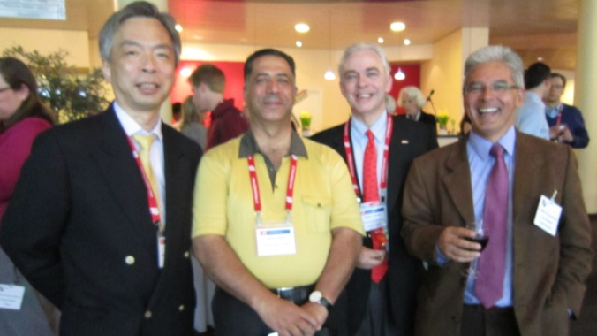
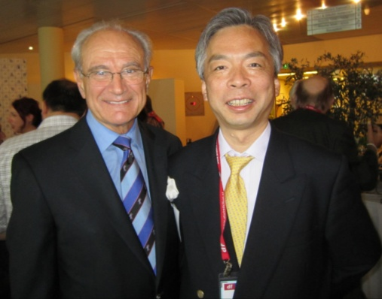
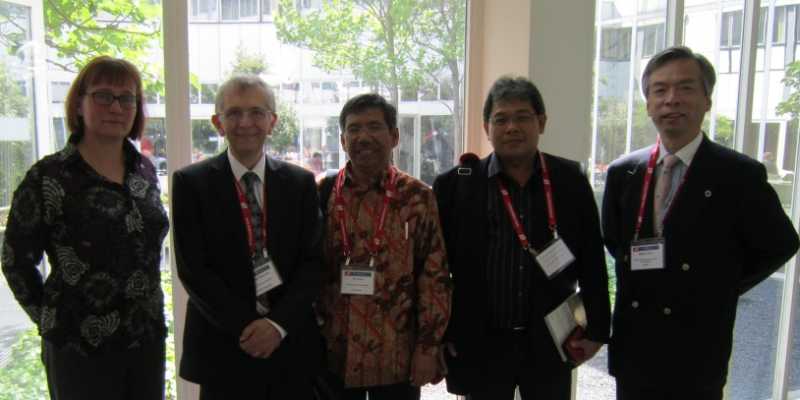
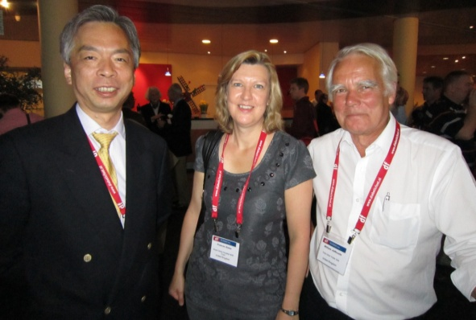
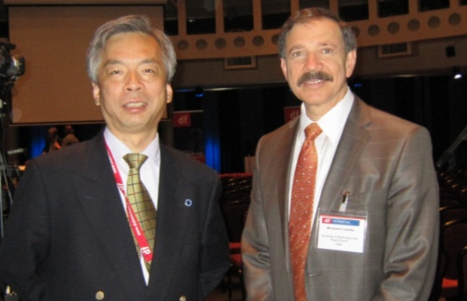
Notes:
Now the diabetic foot problems are major concerns in all over the world. These pictures were taken at the international diabetic foot meeting held in the Netherland last year. As you can see, doctors from all regions attended this meeting. It reflects the global increase of diabetic foot problem

Slide 3


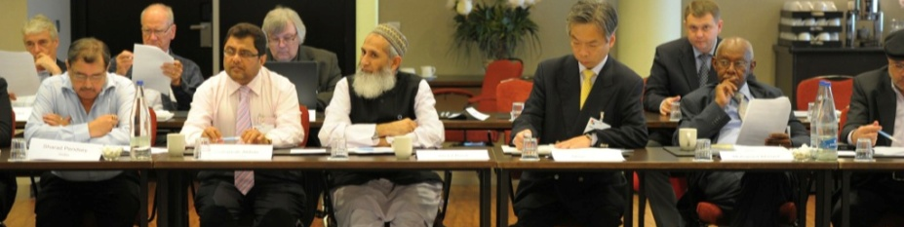
# Infection
# PAD
# Wound Care
Notes:
This international meeting is held every four years. At this meeting, international consensus on the diabetic foot and practical guidelines on the management and prevention of the diabetic foot is made. Last year’s main topic were infection, PAD and wound care

Slide 4
Prevalence of Diabetic Neuropathy in Japan
-Japan Medical Association 2007 -
(n=200,000)
<Japan Med. Assoc. 2007>
Notes:
At first, we want to show you our data of the prevalence of diabetic neuropathy in our country. This clinical study was conducted by Japan Medical association in 2007
(and about two hundreds thousands diabetic patients were examined. Duration of diabetes is 10years and height is about one hundreds sixty cm. Mean HbA1c is 7.1%.)
47% of the patients seem to have diabetic neuropathy to some degree.
And 19% of them have asymptomatic one.
However, in this clinical study, monofilament test was not done and so, the severity of diabetic neuropathy was not evaluated. We speculate that the rate of the patients who cannot perceive 5.07 monofilament is less than a few percent.

Slide 5
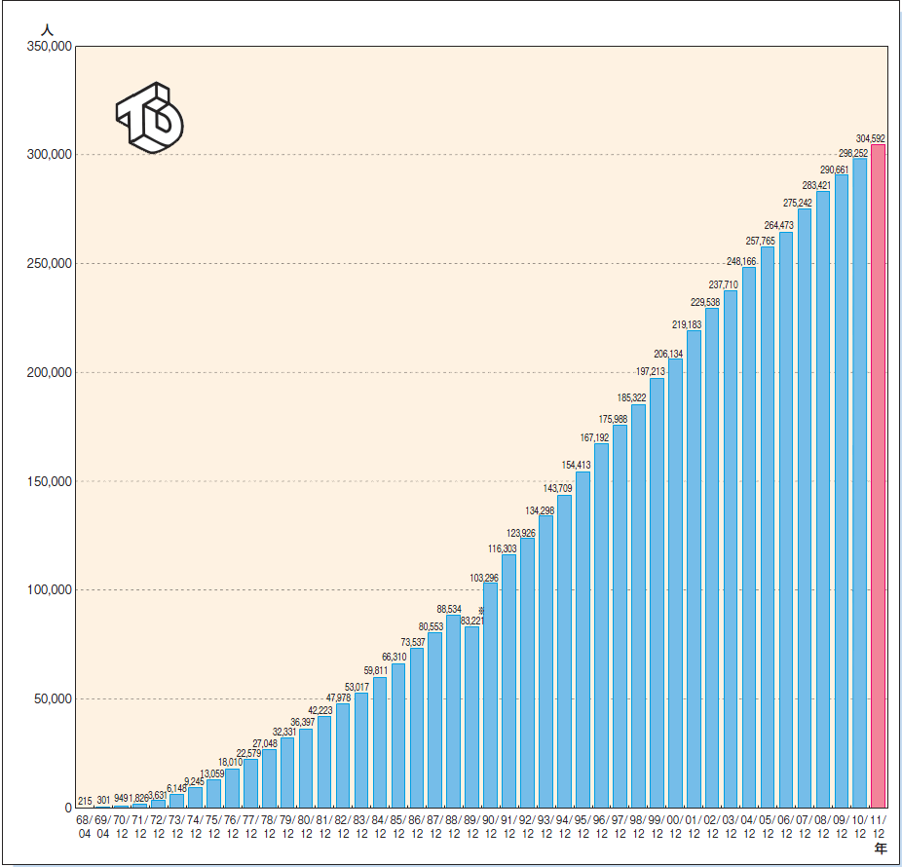
Change of Chronic Dialyzed Patients in Japan
－ The Japanese Society for Dialysis Therapy－
No. of patients
300,000
304,592
150,000
2011
Notes:
As the increase of diabetic patients, the numbers of chronic dialyzed patients are increasing. . In 2011 three hundreds and four thousands patients were under the treatment of chronic dialysis. Now in our country the number of the diabetic foot gangrene in the chronic dialyzed patients is increasing. We are struggling for the limb salvage in these patients.

Slide 6
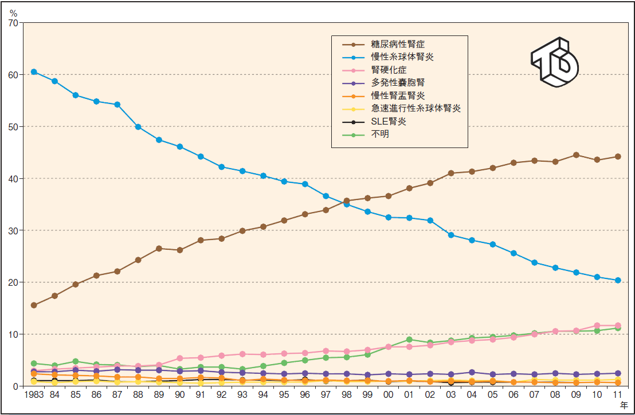
Change of the Cause of Newly Applied Hemodialysis in Japan
－ The Japanese Society for Dialysis Therapy－
Chronic glomerular nephritis
Diabetic Nephropathy
2011
Notes:
This slide shows the change of the cause of newly applied hemodialysis in Japan. The cause by chronic glomerular nephritis is decreasing, while that by diabetic nephopathy is increasing.

Slide 7
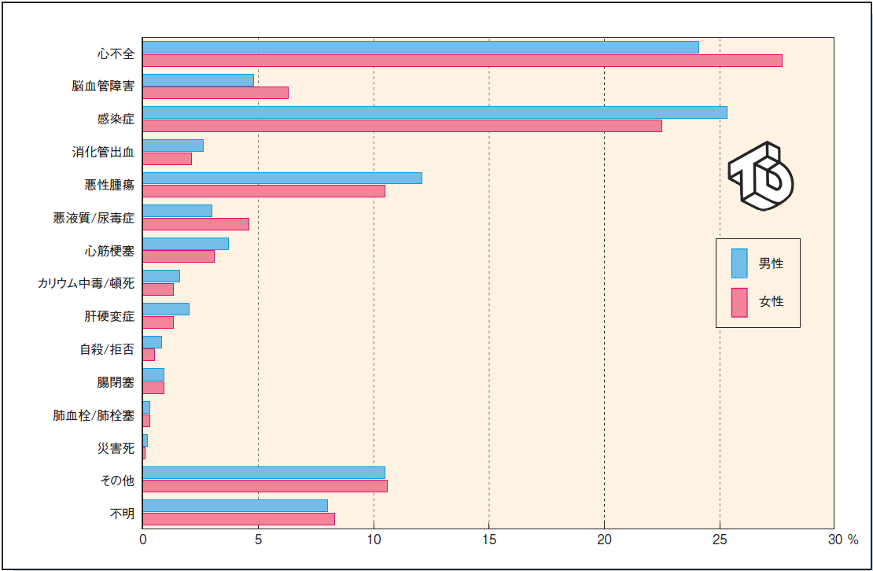
Cause of the Death in Dialyzed Patients in Japan
－ The Japanese Society for Dialysis Therapy－
Heart Failure
Stroke
Infection
Malignancy
Male
Female
Notes:
Dialyzed patients have a poor prognosis of life expectancy. This slide shows the cause of the death in dialyzed patients in our coutry. The major cause are heart failure, stroke, infection and malignancy.

Slide 8
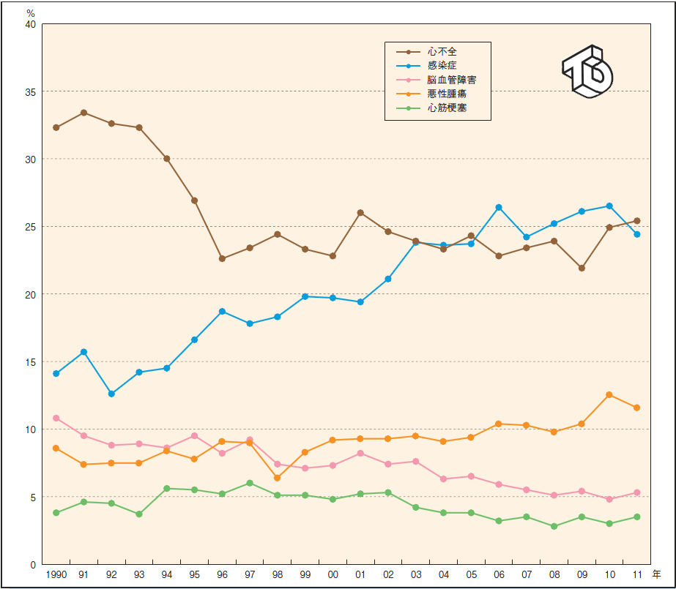
Change of the Cause of the Death
－ The Japanese Society for Dialysis Therapy－
Heart failure
Infection
Malignancy
2011
Notes:
This slide shows the change of the cause of the death. The cause by heart failure is decreasing, while that by infection is increasing.

Slide 9

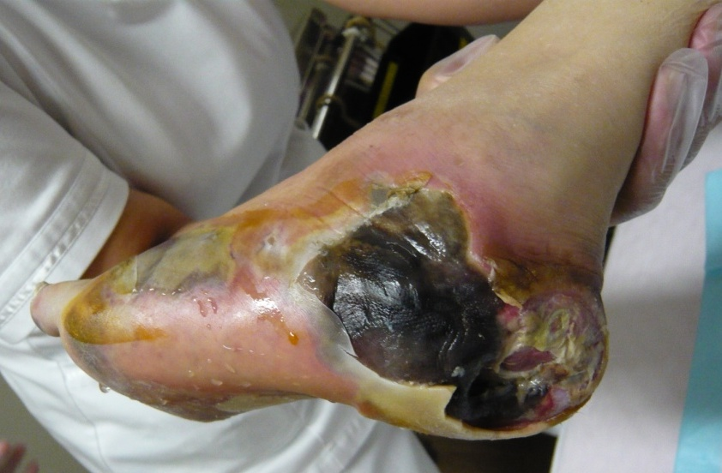
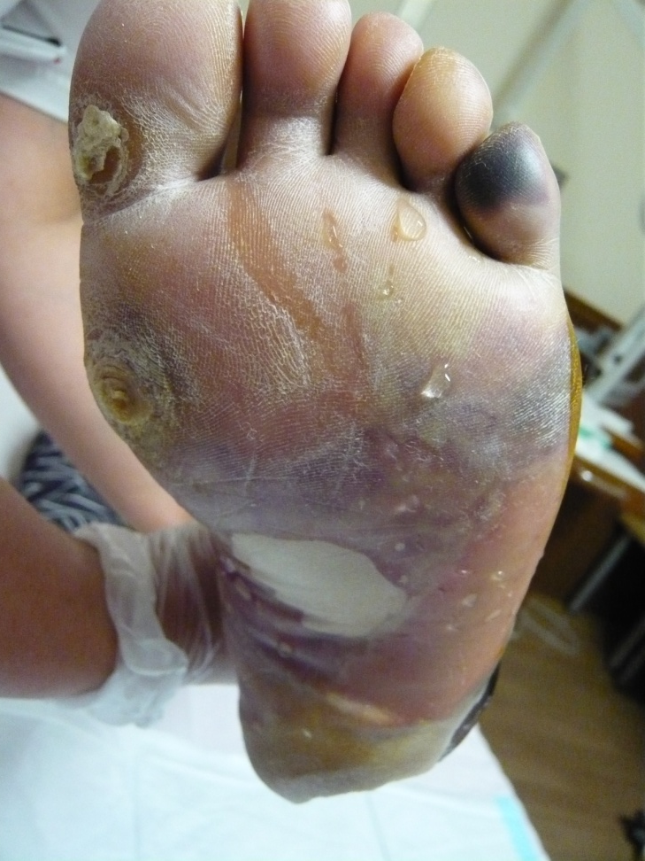
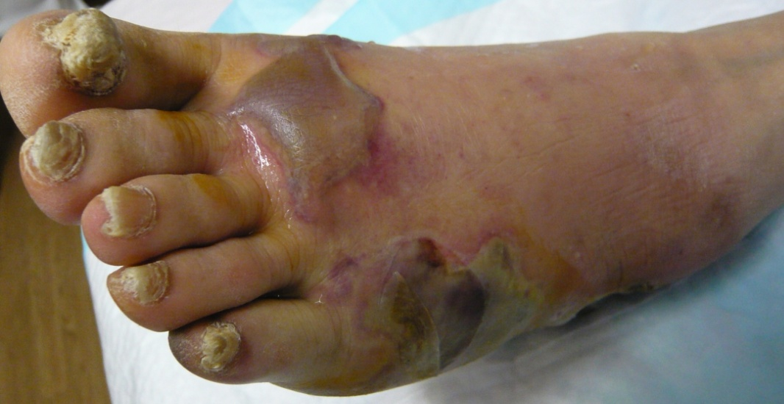
Diabetic Foot Problem in Dialyzed Patient
―Gas Gangrene―
Notes:
I would like to introduce some typical cases of diabetic foot in dialized patients. This patient was referred to our hospital with massive gas gangrene of the foot.
The doctor at the local hospital recommended immediate BKA, but she rejected and asked for a referral to our hospital. Massive necrosis at the heel, plantar and lateral border. bulla, and gas were found.

Slide 10
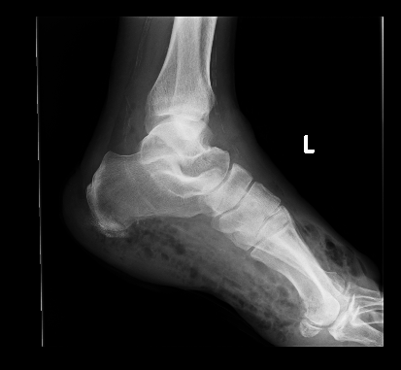
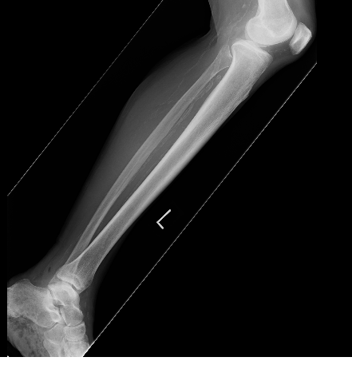
Diabetic Foot Problem in Dialyzed Patient
―Gas Gangrene―
Notes:
X-ray showed broad gas formation in the whole foot and ankle lesion.

Slide 11
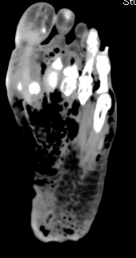
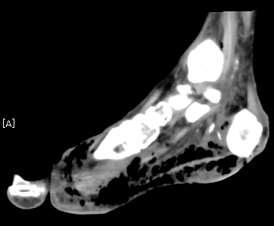
Diabetic Foot Problem in Dialyzed Patient
―Gas Gangrene―
How should we treat this infection for limb salvage?
Notes:
CT also revealed massive gas formation in the whole foot, especially around the plantar fascia..
How should we treat this serious infection for limb salvage? is one crucial question I want to focus today.

Slide 12
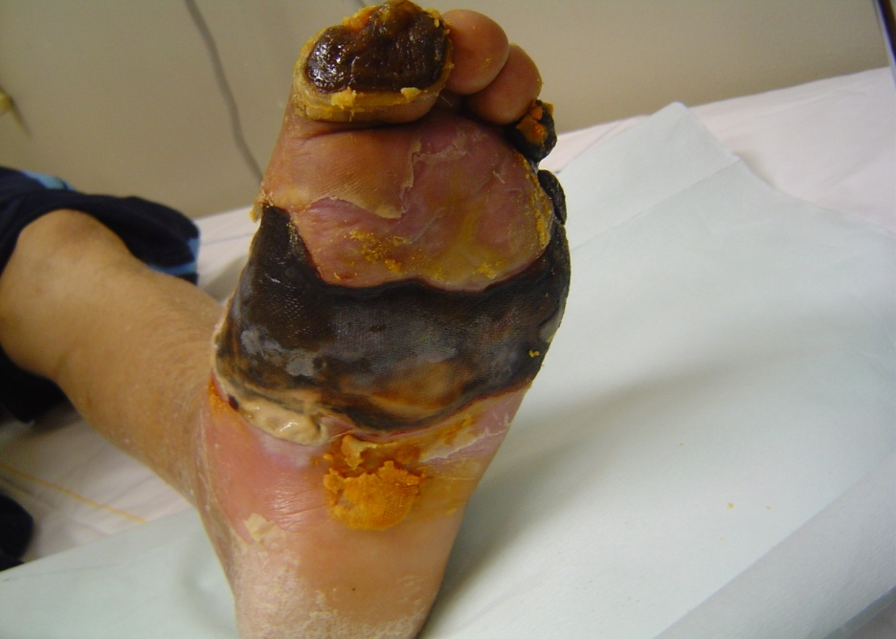
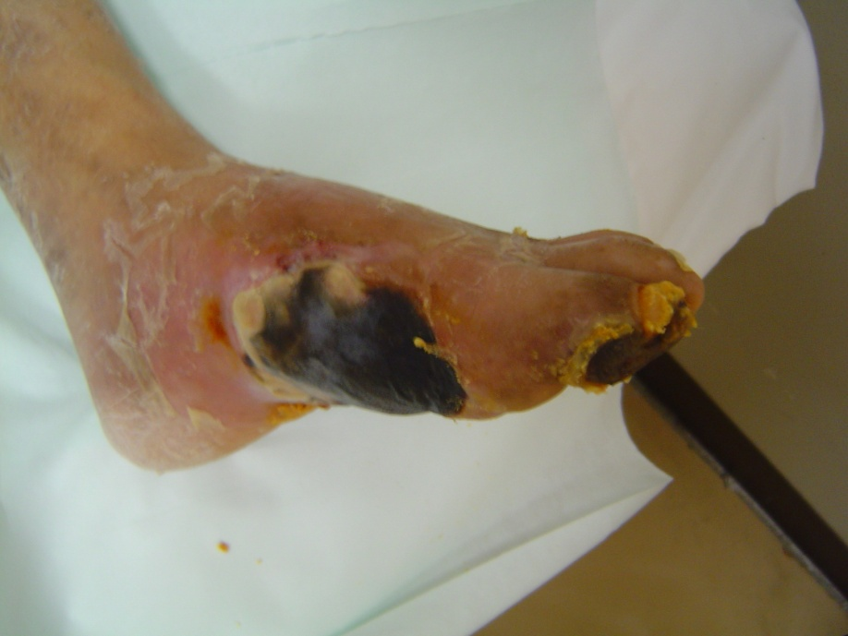
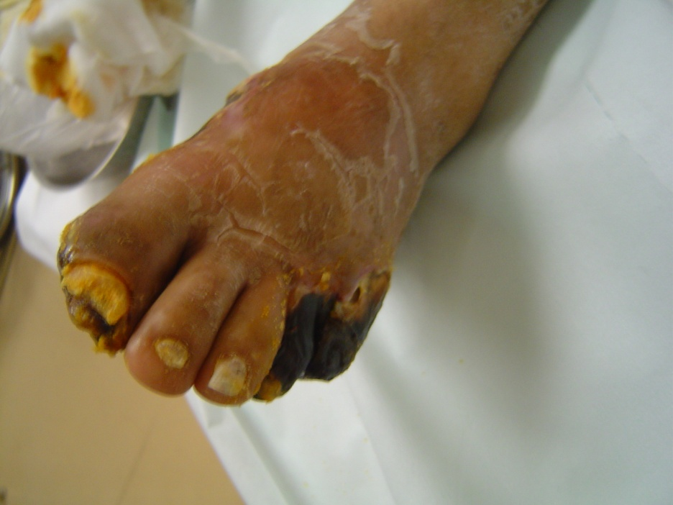
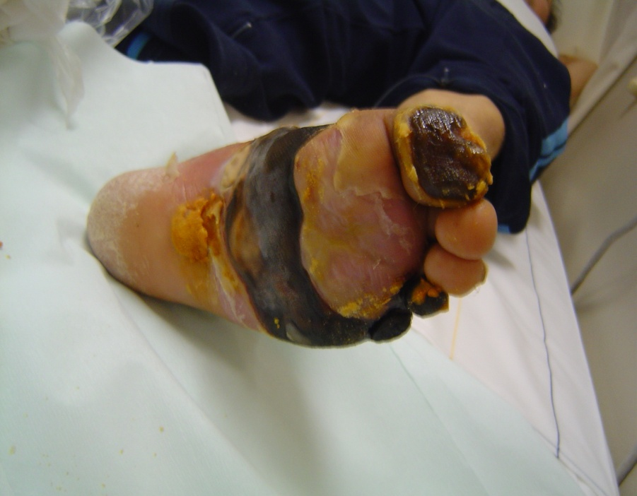
Diabetic Foot (MRSA infection & PAD)
-dialyzed patient, after right BKA-
Can we control this serious infection and critical limb ischemia?
Notes:
This picture is from another one with massive gangrene of the left foot in dialized patient He was infected with MRSA and his foot had a critical limb ischemia. His right was undertaken Below knee amputation at another hospital a few years ago. Can we control this serious infection and critical llimb ischemia? is another crucial question to be solved.

Slide 13
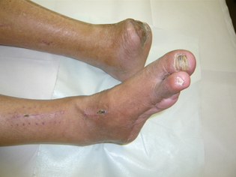
Diabetic Amputee
（A dialyzed patient after distal bypass and minor amputation）
How should we provide the foot wear for amputee?
Notes:
) Next we showed the orthotic for amputated patients, This patients is a dialysed and complicated with PAD and gangrene, and was undertaken bypass surgery and amputation.

Slide 14
Amputation Rate before 2000
（Kyoto Medical Center , Foot Center ）
～2000
Amputation
30.1%
Major Amputa.
18%
2000. Footare Clinic
Notes:
14
This slide shows the amputation rate before 2000 in our hospital. Major amputation rate was 18%.
That is the major reason why we launched diabetic footcare clinic in my hospital in 2000.

Slide 15
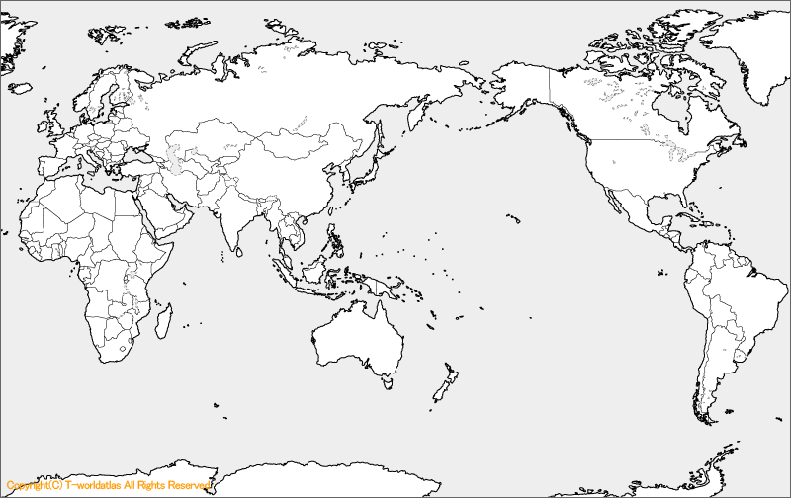
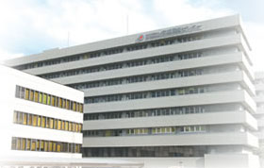
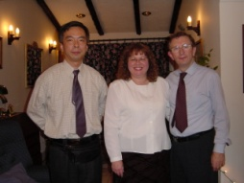
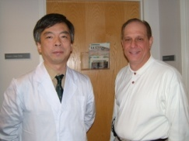
Introduction of Diabetic Foot Care System
King’s College Hospital
(London, UK, 2001)
WHOcc
KYOTO MEDICAL CENTER
Beth Israel Deaconess Medical Center
(Boston, USA, 1999)
Notes:
In order to reduce our amputation rate, we tried to introduce the concept ant skills of diabetic footcare from UK and USA since 1999.

Slide 16
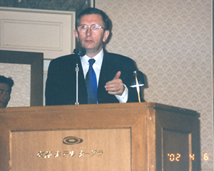
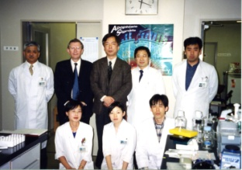
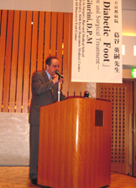

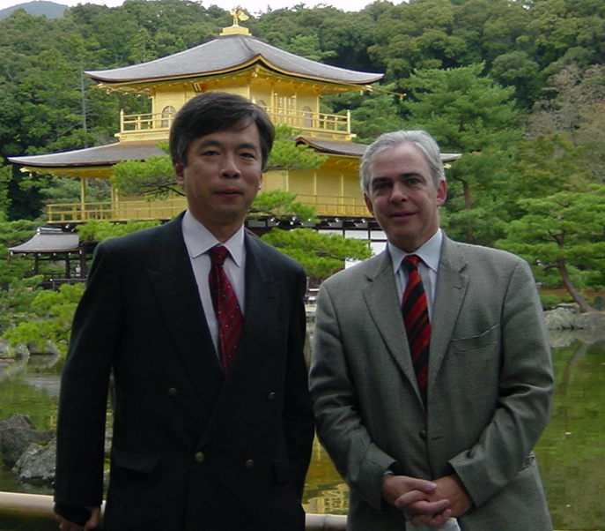
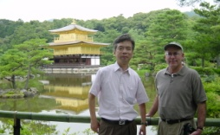
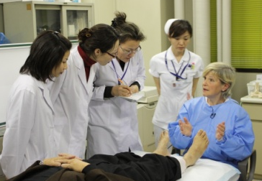
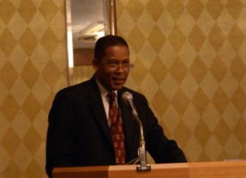
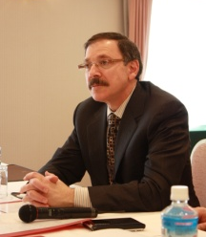
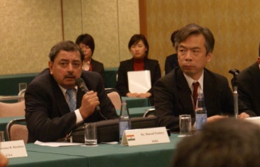
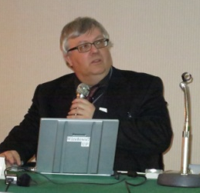
Introduction of Diabetic Foot Care System
Prof. M. Edmonds
(London 2001) (Kyoto 2001)
Prof. J. M. Giurini
(Boston 1999) (Kyoto 2001)
WHOcc
KYOTO MEDICAL CENTER
Prof. A. Boulton
(Kyoto 2003, 2006)
Dr. T. Lyons
2003
Dr. A. VM Foster (Kyoto 2009)
Prof. L. Harkless
(2004, 2007)
Prof. A. Lipsky
(2011)
Dr. S. Pendsey
(Kyoto 2007 )
Prof. J. Apelqvist (Kyoto 2012)
Notes:
We invited many famous specialists to our center and they kindly shared their experience and knowledge.

Slide 17
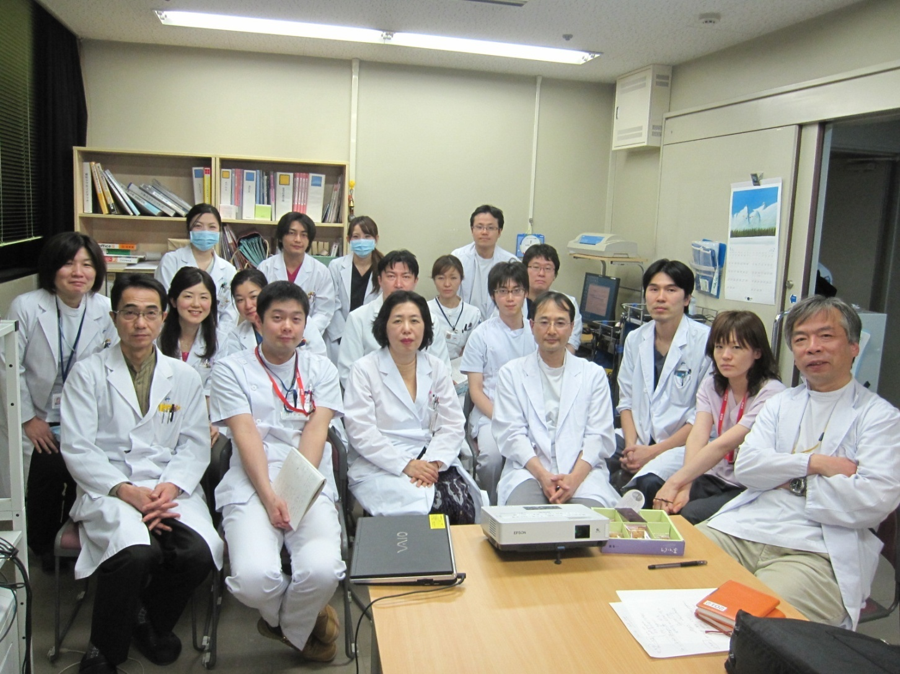
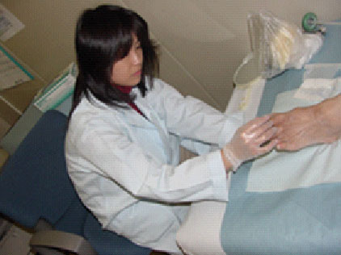
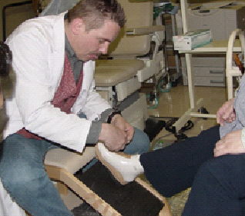
Multidisciplinary Team Approach
- Kyoto Medical Center -
Diabetologist
Dermatologist
Vascular Surgeon
Cardiologist
Orthopedic Shoe Meister
Podiatrist
Trained Nurses
Orthopedic Surgeon
Plastic Surgeon
Foot Conference
Notes:
Following foreign specialists’ advice, we formed a multidisciplinary approach. The foot team includes a US trained Japanese podiatrist, Austrian Orthopedic shoe meister and vascular surgeon who can have an excellent technique of distal bypass surgery. They covered the deficits in our health care system, that is, no podiatrists and no pedorthists.

Slide 18
Diabetic Foot Problem in Dialyzed Patient
―Gas Gangrene―
Notes:
I would like to introduce some typical cases of diabetic foot in dialized patients. This patient was referred to our hospital with massive gas gangrene of the foot.
The doctor at the local hospital recommended immediate BKA, but she rejected and asked for a referral to our hospital. Massive necrosis at the heel, plantar and lateral border. bulla, and gas were found.

Slide 19
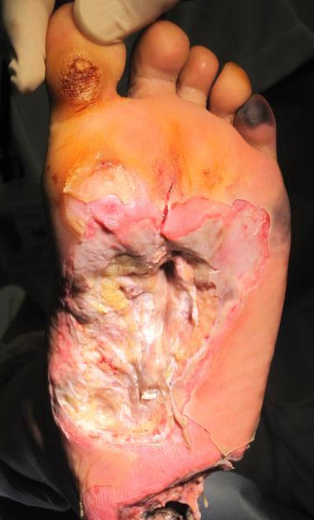
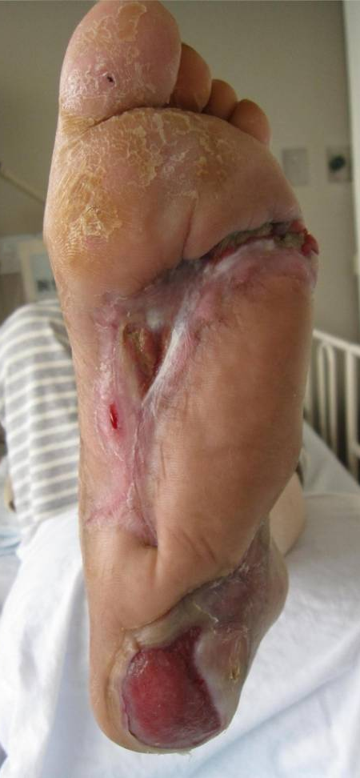
Gas Gangrene in a Diabetic Foot Infection
On Admission
3 months later
Notes:
Our surgeons performed aggressive daily wound debridement. Repeat bacterial cultures of wound tissue grew Streptococcus agalactiae, and a coagulase-negative staphylococcus (methicillin-resistant). We added clindamycin to the meropenem and vancomycin antibiotic therapy. Her infection resolved and the foot healed

Slide 20
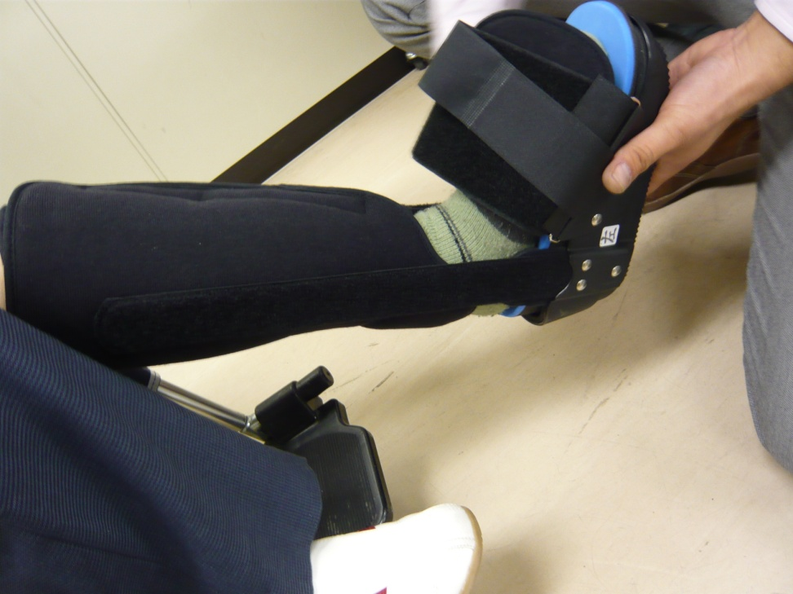
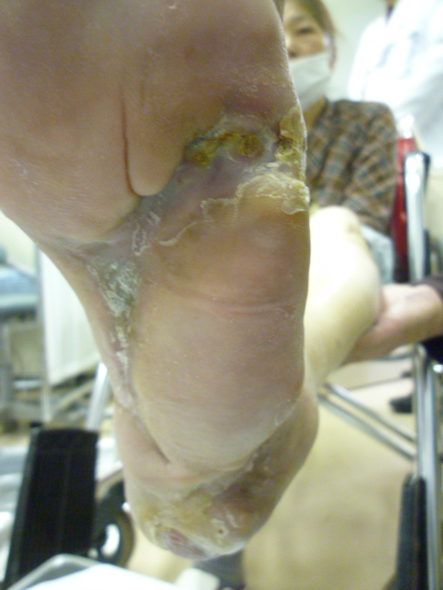

Gas Gangrene in a Diabetic Foot Infection
6 months later
Notes:
Not PTB
6 months later she was able to walk .with orthosis with王t amputation.

Slide 21
Diabetic Foot (MRSA infection & PAD)
-dialyzed patient, after right BKA-
Notes:
This picture is from another one with massive gangrene of the left foot in dialized patient He was infected with MRSA and his foot had a critical limb ischemia. His right was undertaken Below knee amputation at another hospital a few years ago. Can we control this serious infection and critical llimb ischemia? is another crucial question to be solved.

Slide 22



Debridement after bypass surgery
Poplitea a.- Doralis Pedis a
Bypass
# No enough autologous vein
# Artificial graft vein
( From Dr. Masashi Inaba)
Notes:
Vascular surgeon undertook bypass surgery from poplitea to dorsalis pedis artery. using partially artificial graft connected to autologous vein. After the bypass surgery, necrosis was surgically debrided.

Slide 23


One month after bypass surgery
( From Dr. Masashi Inaba)
Notes:
This picture shows the foot one month after bypass surgery.

Slide 24


Free Muscle Cutaneous Flap
(Rectus Abdominis Muscle)
Notes:
Free muscle cutaneous flap was transplanted from rectus abdominus muscle.

Slide 25




Vein graft
Epigastrica
Inferior
Muscle flap
( From Dr. Masashi Inaba)
Notes:
Vascular surgeon bypassed between popliteal artery and distal artery by using a partialy artificial graft.

Slide 26




( From Dr. Masashi Inaba)
Notes:
At last his left foot was salvaged and he began to walk on his own foot.

Slide 27


Footwear Unit
- Foot Center, Kyoto Medical Center-
Austrian Orthopedic Shoemaker ( Meister )
Notes:
Next I would like to show the work in the footwear unit in our center.

Slide 28

Diabetic Charcot Foot
Notes:
28
This patient is a Charcot foot with ankle deformity.

Slide 29





Diabetic Charcot Foot
Kyoto Medical Center
Notes:
29
29
We made custom made shoes and insole for him to accommodate his deformity and support his leg not to bend on standing and walking..

Slide 30
Diabetic Amputee
（A dialyzed patient after distal bypass and minor amputation）
Notes:
This patients is a dialyzed and complicated with PAD and gangrene, and was undertaken bypass surgery and amputation.

Slide 31


Diabetic Amputee
（A dialyzed patient after distal bypass and minor amputation）
Walking pattern on his own shoes and its plantar pressure
Notes:
This slide shows his gait on bare foot. You can see a markedly abnormal high plantar pressure at amputated foot.

Slide 32


Diabetic Amputee
（A dialyzed patient after distal bypass and minor amputation）
Notes:
Inner shoe was custom made to compensate his tissue defect and make his gait less energy expenditure and more comfortable.

Slide 33


Diabetic Amputee
（A dialyzed patient after distal bypass and minor amputation）
Walking pattern on custom made orthotics and its plantar pressure
Notes:
With this orthotics, he can walk faster and more comfortably. Markedly elevated foot pressure also decreased.

Slide 34

Movement of the center of the body weight gravity
Without orthotics
With orthotics
Notes:
Center of the body weigtht gravity has changed from lateral to the central portion.

Slide 35
Outcome of Footcare
（Kyoto Medical Center , Foot Center ）
～2000
2001～2004
2005～
Amputation
30.1%
21%
21%
Major Amputa.
18%
9%
5%
2000. Footcare Clinic
2002. Footwear Clinic
2003.4. Dermatology Foot Clinic
2003.9 Foot center
2006.4. Vascular Surgery Clinic
Notes:
35
These multidisciplinary team approach made us succeed the reduction of major amputation rate from 18% before 2000 to 5% .
When Dr. Michael Edmonds came to our center at 2002, he told us that we could reduce amputation rate by 50% by multidisciplinary approach. Now we have succeeded to reduce it as Dr. Edmonds predicted. These data showed the efficacy of multidisciplinary approach to compensate the role of podiatrists and orthotists in our country. And since last year our government has decided to reimburse the patient receiving preventive footcare.

Slide 36







Long-term Prognosis of Diabetic Foot Patients
－Recurrence and Amputation after discharge－
Amputation
(at discharge)
Recurrence
75%
Re-Amputation
25%
43 Cases
9
cases
12
cases
3
cases
Amputation
(at discharge)
After
7.2
±2.1
years
Recurrence
Rate
55.8%
Amputation
Rate
11.6%
Yes
None
No Amputation (at discharge)
Recurrence
of Foot Ulcer
48.4%
Amputation
6.6%
15
cases
31
cases
2
cases
Notes:
36
Many reports showed that diabetic foot patients had a high rate of recurrence and poor prognosis of life expectancy. Next, we surveyed long-term prognosis of diabetic foot patients who were healed completely at discharge and have been followed up in these national hospitals after discharge for more than 5 years.
We collected the data of 43 cases from these hospitals, of which 12 cases were amputated at discharge. 75% of these amputee had recurrence of foot ulcer and 25% were re-amputated after 7.2 years.. On the contrary, for these cases without any amputation, the recurrence rate was 48% and amputation rate was 6.6%.

Slide 37


Long-term Prognosis of the Diabetic Foot Patients
-Cardiovascular disease-
Ischemic Heart Disease
Stroke
あり
23.3％
あり
32.6％
なし
67.4％
なし
76.7％
at Discharge
After 7.2± 2.1 y.
at Discharge
After 7.2± 2.1 y.
Notes:
37
37
37
However, during 7.2 years after discharge, the prevalence of ischemic heart disease increased from 14 % to 33% and that of stroke from 8% to 23%.

Slide 38
Cause of the death after discharge
（67.8 ± 12.4 y.o (at discharge), after 5.3 ± 3.9 y）
Notes:
(n=19)
Next we examined the data of the patients who had been followed up after discharge and died in these national hospitals. 42% died because of coronary heart disease, 32% by renal failure and 5% by stroke.
These data indicates that we should be fully careful of CVD , especially silent asymptomatic disease as well.

Slide 39



Multidisciplinary Team Approach
- Kyoto Medical Center, Kyoto, Japan-
Cardiologist
Brain Surgeon
Foot Conference
Notes:
And so, we asked cardiologisst and Brain surgeons to join our team approach for diabetic foot management.

Slide 40





Diabetic Foot in WPR
As the increase of type 2 diabetes, the number of diabetic foot lesions and consequently amputations is increasing in WPR. However, there are very few foot care specialists such as podiatrists as well as footwear specialists like pedorthists in WPR and there is much ignorance amongst medical staff as to how to identify those at risk and treat those who develop problems.
Furthermore, data about diabetic foot in WPR are very rare.
Notes:
Next, I would like to introduce the diabetic foot problems in western Pacific regions. As the increase of type 2 diabetes, the number of diabetic foot lesions and consequently amputations is increasing in WPR. However, there are very few foot care specialists such as podiatrists as well as footwear specialists like pedorthists in WPR and there is much ignorance amongst medical staff as to how to identify those at risk and treat those who develop problems.
Furthermore, data about diabetic foot in WPR are very rare.

Slide 41















International Medical Collaboration in WPR and SEA
- Diabetic Foot Care -
Mongolia
Vietnam
Vietnam
China
China
2001
2002
2003
India
WHO cc, Kyoto, Japan
Cambodia
Vietnam
Philippines
WHO-WPRO
Malaysia
Thailand
Indonesia
Taiwan
Tonga
Notes:
I would like to introduce briefly our international collaboration with Asia Pacific countries shown here in
the field of diabetic foot management.
Since 2001, we have accepted the doctors from Vietnam and China for practical training of diabetic foot care. Through the discussion with them, we noticed that diabetic foot problems followed by amputation are increasing rapidly in our region. After they returned to their countries, they opened foot care clinic in their hospitals. They and WHO-WPRO asked us to visit and help them.
And so. since 2004, Our staff and I have visited several Asian countries for medical collaboration every year.

Slide 42























Kyoto Foot Meeting
2006
2007
2008
2009
2010
2011
2012
Notes:
Since 2006, we have invited doctors and nurses from Asia Pacific regions to hold an international meeting once a year , named Kyoto Foot Meeting, in order to discuss the diabetic problems and its complications in WPR , especially foot problems, closely collaborating with WHO.

Slide 43




Practical Training Course of Footcare for Doctors
KYOTO FOOT MEETING 2008
Kyoto Foot Meeting 2008
Notes:
In 2008 and 2012, we held a practical training course of diabetic foot management for young doctors from Asian countries in our hospital.

Slide 44



Kyoto Foot Meeting 2009
- Practical training course of diabetic footcare for nurses-
Nurses from
Vietnam
Mongolia
China (Zhengzhou)
Japan
(1~2 months)
Notes:
.
In 2009, we invited nurses from China, Vietnam, and Mongolia for practical training of foot care, especially preventive foot care. They stayed in our hospital for one or two months. We invited a British famaous podiatrist, the late MS Ali Foster from London, UK to teach them.

Slide 45


Website “ To Save the feet in WPR”
-Educational materials on our website(2010.10 -)-
http://kyotofootcare.jp
Notes:
We made up and opened our website in order to raise awareness of diabetic foot problems amongst diabetic patients and healthcare professionals in WPR. Furthermore, we are uploading our educational materials for foot care from which anyone can download freely.

Slide 46
Multinational study of diabetic foot in the Western Pacific Region
– ASIPAC FOOT STUDY –
ASIPAC-1: Diabetic Foot Patients Hospitalized in
Participating Hospitals
ASIPAC-2: Diabetic Charcot Foot Patients
ASIPAC-3: Lifestyle of Diabetic High-Risk Foot
Patients
Notes:
On these common backgrounds in the Western Pacific Region, we launched the multinational collaborative study of diabetic foot with our Asian friends and Prof. Boulton. The name of the study is ASIPAC foot study. We investigated the characteristics of diabetic patients with foot ulcers and their lifestyles in WPR.

Slide 47
ASIPAC FOOT STUDY
Participating Hospitals for Study
VIETNAM: National Endocrinology Hospital
(Hanoi)
THAILAND: Theptarin Diabetes Center
and Hospital (Bangkok)
PHILIPPINES: Jose R. Reyes Memorial Medical
Center, Diabetic Foot Care Clinic
(Manila)
INDONESIA: Cipto Mangunkusmo Hospital
(Jakarta)
CHINA: Henan Provincial People’s
Hospital (Zhengzhou)
MONGOLIA: Health Science University of
Mongolia, Department of
Endocrinology (Ulaanbaatar)
Cambodia: Kosamak Hospital,Phnom Phen
JAPAN: Kyoto Medical Center, WHO-
collaborating Centre for
Diabetes (Kyoto)
Tertiary care hospital in urban city
Notes:
Eight hospitals appointed as central tertiary care hospital and located in urban area in Vietnam, Thailand, Philippines, Indonesia, China, Mongolia, and Japan participated this study.

Slide 48
ASIPAC FOOT STUDY -1,2
Summary 1
The characteristics of diabetic foot patients in WPR were much different in some points from those reported from developed countries.
# Younger age and shorter duration of diabetes
# Males are not predominant
# Late presentation
# Trauma during walking on barefoot or with sandal
# Bacterial profile
# High amputation rate
# Late diagnosis and poor prognosis in Charcot patients
# Appropriate footwear or orthotics are seldom provided
Notes:
To summarize the characteristics of diabetic foot patients in WPR, they were much

Slide 49
Profile of bacteria isolated from foot ulcers
Sometimes no bacterial culture and Gram stain smear
Notes:
This slide shows bacterial profile isolated from foot ulcers. The bacterial profile varied widely between countries and surprisingly, staphylococcus infection was not most predominant in some countries. Furthermore, in some developing countries sometimes no bacterial cilture and Gram stain smear was done even in critically ill patients , but antibiotics were prescribed

Slide 50
ASIPAC FOOT STUDY -3
Summary 2
The lifestyles of diabetic patients in WPR were much different in some points from those reported from developed countries.
# Preference of sandals or slippers
# High prevalence of foot trauma inside the house
and while wearing sandals outside the house
# They believe natural healing or they can treat foot
ulcer by themselves
# They can buy antibiotics without prescription
# Late consultation with very advanced and
complicated foot problems
Notes:
In the third study named ASIPAC FOOT STUDY 3, we studied the lifestyle of diabetic patients in WPR. We found in them
# Preference of sandals or slippers
# High prevalence of foot trauma inside the house
and while wearing sandals outside the house
# They believe natural healing or they can treat foot
ulcer by themselves
# They can buy antibiotics without prescription
# Late consultation with very advanced and
complicated foot problems

Slide 51


IDF-WPR Diabetic Foot Care Project in Western Pacific Region
Advisory board
Western Pacific Region
Backgrounds
IDF-WPR
# Increase in diabetic foot problems
# High amputation rate
# High mortality
# Impaired quality of life
# High medical cost
Experts in WPR
WHO
Foreign Experts
Aims
・to raise the awareness of diabetic foot
・to improve the skills of foot care
・to implement the regional strategy on
prevention and management of diabetic foot
Executive board
SPC
TASKFORCE
IDF-WPR recognized diabetic foot center (IDF-WPR DFC)
China
Australia
Mongolia
To develop regional guidelines
“Diabetic Foot Care in WPR”
Cambodia
Philippines
Japan
IDF-WPR DFC
China
Taiwan
■ Project meeting
■ Training course (3days)
■ Preparation of materials
■ Technical support
( IT, Website)
■Educational seminar
■Survey of foot problems
■Implementation of the
regional guidelines
Fiji
Thailand
Indonesia
Vietnam
Expected
outcome
● Reduction of foot ulceration and amputation
● Improvement in patients’ quality of life
Korea
Network
Notes:
In order to reduce amputation and improve the patient’s QOL and ADL, we launched the diabetic footcare project as one of the main project in IDF-WPR, closely collaborating with WHO.

Slide 52





The training course of Diabetic Footcare for Doctors
― KYOTO MEDICAL CENTER, Kyoto, Japan February 2012 －
Doctors
From
Cambodia Indonesia
Notes:
For this purpose we held a training course of diabetic foot care for doctors. Seven doctors were invited from Cambodia and Indonesia in the February, this year.
52

Slide 53




















IDF-WPR FOOT CARE PROJECT MEETING 2012
( Kyoto, Japan, February 23-25, 2012 )
Prof.Jan Apelqvist
Senior consultant, Department of Endocrinology ,
University Hospital of Malmö (Skåne University Hospital)
Malmö, Sweden
Notes:
After the training course we held the 1st meeting of this IDF-WPR footcare project.

Slide 54
Diabetic Foot Care Project (IDF-WPR DFC) in Western Pacific Region
Action Plan
We will
evaluate regional characteristics of diabetic foot in WPR more precisely
organize the network system (IDF-WPR recognized diabetic foot center) to support together
develop regional clinical guidelines directly applicable to the regional lifestyle
Notes:
40) In conclusion, our action plan is
We will evaluate regional characteristics of diabetic foot in WPR more precisely
organize the network system (IDF-WPR recognized diabetic foot center) to support together develop regional clinical guidelines directly applicable to the regional lifestyle

